Slide 1

2025 Kiribati Population and Housing Questionnaire training
Kiribati National Statistics Office

Slide 2
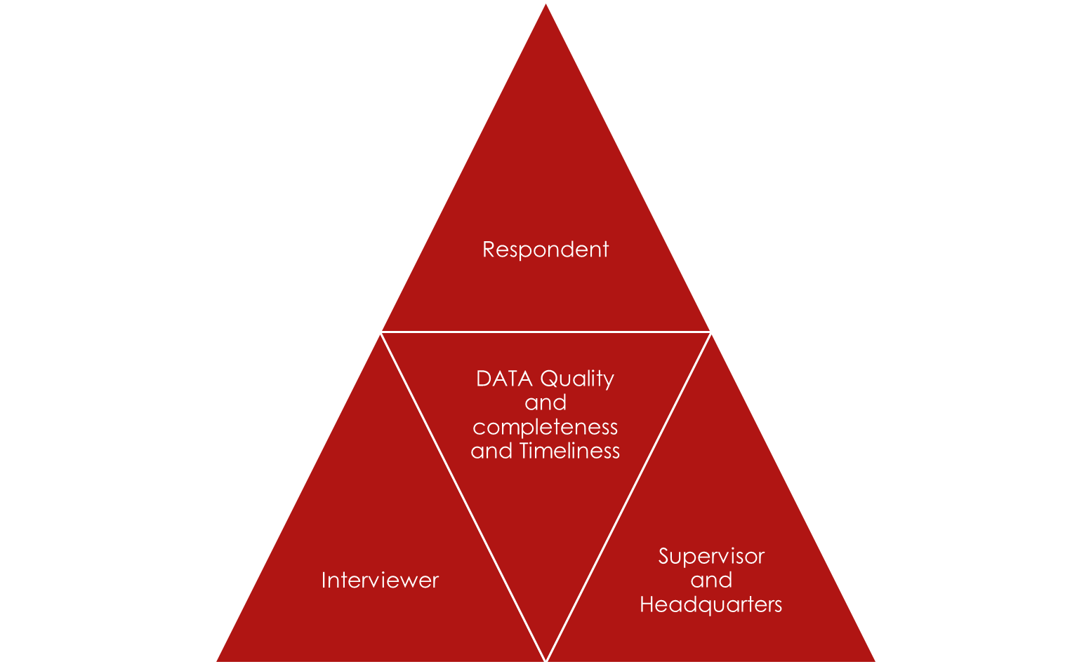
GOOD QUALITY COMES FROM
GOOD TRAINING
GOOD INTERVIEWING
GOOD MONITORING FROM FIELDWORK
GOOD DATA VALIDATION
FROM SUPERVISORS AND HEADQUATERS
GOOD MORAL TEAMWORK

Slide 3

ROLE OF SUPERVISOR
BE ABLE TO LIAISE WITH ISLAND COUNCIL ON ANYTHING RELATED TO PROJECT AND RESPONDENTS.
SUPERVISORS – ORGANISE TEAM – DRAW WORKPLAN FOR ACCOMPLISHING EACH TASK AND SUBMIT TO NSO
VISIT ONE INTERVIEW TO BE CONFIDENT OF THE INTERVIEW
ACCOMPANY INTERVIEWERS TO ENSURE SAFETY OF THE INTERVIEWERS
ENSURING MONITORING AND EVALUATION ON DATA FROM THE FIELD ARE DONE EVERYDAY
CARRY OUT SPOT CHECKS ON SPECIFIC QUESTIONS WITH INTERVIEWERS OR AS INSTRUCTED BY HEADQUATERS OR NSO ADMIN
REPORT DAILY ON ISSUES, CHALLENGES, SUCCESS STORIES. FROM THE WEATHER TO THE PEOPLE
FINAL REPORT ON COMPLETENESS OF WORK FROM EACH ISLAND.
CLARIFY ON QUESTIONS FROM INTERVIEWERS, OUTER ISLAND RESPONDENT
REPORT ON ANY MISCONDUCT ON VEHICLES HIRED

Slide 4
Interviewer role: You are empowered by the NSO law to collect official statistics for Kiribati.
TE MOAN BWAI, SAY MAURI , GREETINGS
You are respected and expected to be respectful.
NO SHORTS LADIES, WEAR SKIRT
Look tidy
NO chewing gum, kouben, smoking in people’s houses
NO consumption of Alcohol now or 24 hrs prior to fieldwork
Be confident on the subject matter of the questionnaire
Be a good team-player – complete your part! Listen and follow instructions
Be extra careful with the equipment you are trusted with – tablets
More Importantly be extra cautious with the DATA that you collected.
Make sure you complete your part AND ALWAYS THANK THE RESPONDENTS.

Slide 5
CONFIDENTIALITY
1. E TABUROROKO NORAN TE DATA ARE TI NA RIKOI MAIROUN AE TIAKI TE TIA MAKURI, e,g buum, tarim, raraom ao aomata riki tabem
2. E TABUROROKO kabonganakin te bwai n makuri n aki akaka ao irouia aomata tabeman ae tiaki taan makuri.
3. E TABUROROKO taetaekinan kanoan te makur, bwaai ake a riki n te field nakon ae tiaki taan makuri, report ni kabane nakon supervisors.
4. TE RAW DATA TII BWAIN TE AOBITI A TABUROROKO TIAKI TAAN MAKURI N NORI N AKEA TE KARIAIAKAKI.
NGKANA E AKI SAFE TE TABO N WAREWARE AO KONA N RAONAKI TE INTERVIEWER MA E NA AKI ONGORA TE TIA RAONA TE INTERVIEWER TE RESPONDENTS REPLY.
LET THIS BE A WARNING

Slide 6
Respondents
Respondents are the very important customers bwa rongorongoia kain Kiribati e roko man te auti teuana ma teuana. Ibukin kakawakiia
E tabuaki te manging n tain te makuri ke 24 hr imwain mwakurim. AKEA TE MANGING AO TE BOI MANGING.
No kouben!! Bon akea riain ae ko na kaekaia kain te auti ao ko kouben bwa ana aki ongo raoi nanon am kakarabakau.
WORK SMART WHEN ASK A QUESTION. KAKAUONGO RAOI NAKON AIA KAEKA BWA N TABETAI AO A KONA N KARAKI AO ANGANIKO BOON AM TITIRAKI AIKA A BATI.
KATAIA N ENJOY TE INTERVIEW KANGA TE KAKARAKI AO E NA BEBETE BUTIMAEANA IROUIA.
OBSERVE BWA NGKANA E KAINANO KE N BOTU KE IAI TABENA AIKA A KAOTI AO BREAK AO RE APPOINT ANOTHER TIME MA AM RESPONDENT N ANA CONVENIENCE TE RESPONDENT, MARK THAT IN YOUR TABLET.

Slide 7
THIS IS NOT THE FIRST Census!!
SO:
LET US CHALLENGE OURSELVES IF THEY CAN DO IT, WE CAN DO IT BETTER E.G IF SAMOA CAN DO IT, WE CAN DO IT BETTER.
EVERYTHING IS POSSIBLE
WE ARE IMPROVING THE ONE WE HAVE BEFORE
WE WANT TO REWARD OURSELVES TO BE PART OF THIS UNDERTAKING
IF WE FILL WE ARE NOT SUITABLE TI NA MOANTAAI N REPORT.
E KONA N IAI TE TEST NI KATOA TE TAI A BANE N TAUAKI BWIIA TAI TAKAKARO!
TI NA TAI MONA MA TI NA WAAKI MA TE UNGA N NANO.

Slide 8
Way forward / E uara??
Now that we are almost ready: LET ME REMIND AGAIN
Kanoan te training - Statistics Training are different, when we build capacity we really mean it. In the trainings we normally have tests at the end of the training or during the everyday end of session. Taua ma nanomi akea te takakaro n ana training te Statistics bwa e kakawaki te quality of data ibukin etin raoi kainibaire ake a na kabonganai ara ware ake ti rikoi man kaotinakoi man ara surveys ke ara census ke ara data collection are a tia n karaoaki raoi ma te eti.
Ti na kantaningaia bwa kam na aki miss kanoan ara bong ao ara test bwa iai te bwi ae tatauaki iai.
Kam rabwa ao tekeraoi te training ao tai mwaninga are iai te test ni katoa bong.
AMI TITIRAKI IAON AEI??

Slide 9
Defacto vs Dejure Population Census
Kiribati has been using Defacto census method, at which it enumerates people at where they reside within Kiribati National boundary, regardless of whether that is their usual or permanent residence.
Dejure census method: counts people according to their usual or legal place of residence (where they normally live), even if on the census day they are temporarily elsewhere

Slide 10
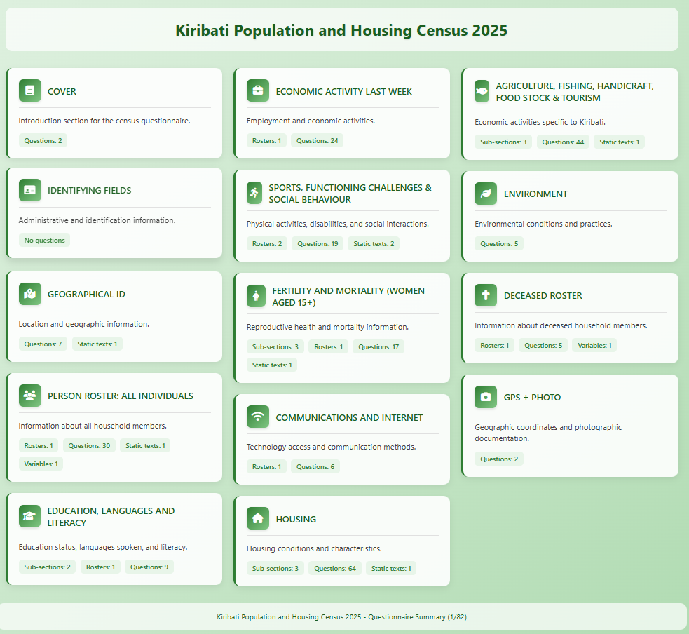




Slide 11
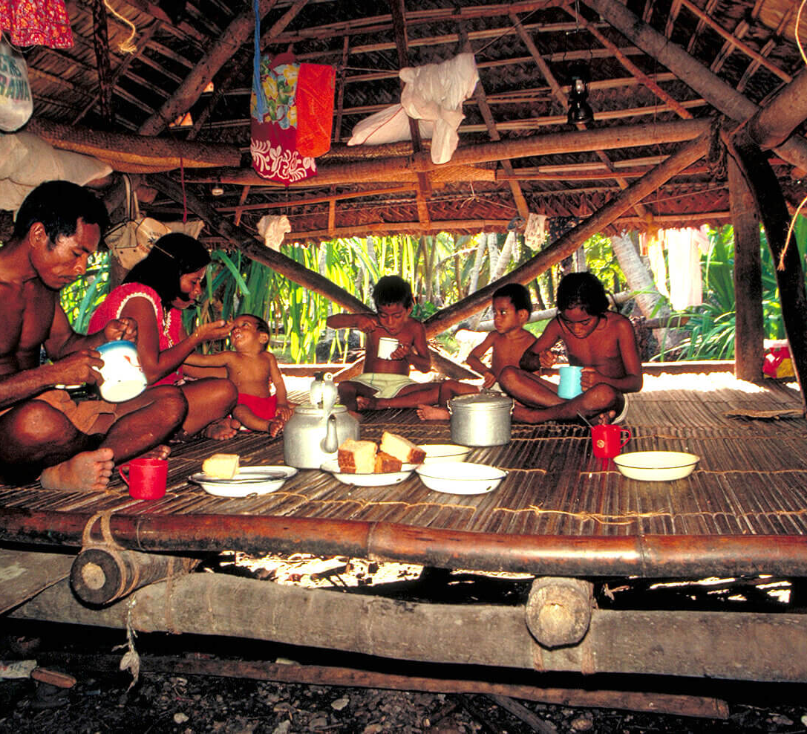
DEFINE HOUSEHOLDS
Refer to a group of people living and eating together under one roof.
( all individuals)
Example: It can be 1 or
more houses lived together
sharing meals and other expenses

Slide 12
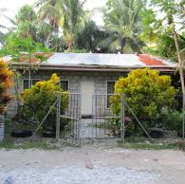
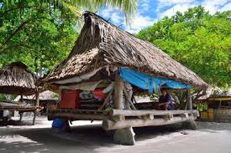
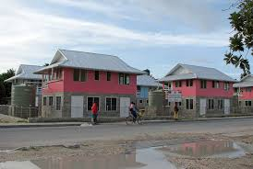
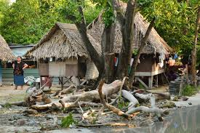
DEFINE DWELLING
Refer to living houses, flat, apartment, where people reside or live at.

Slide 13
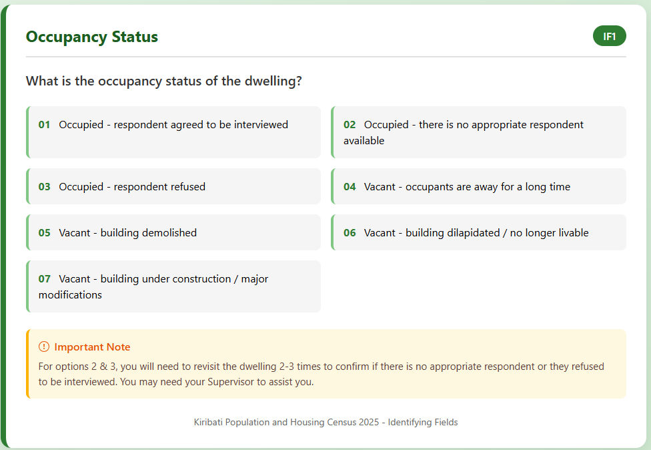
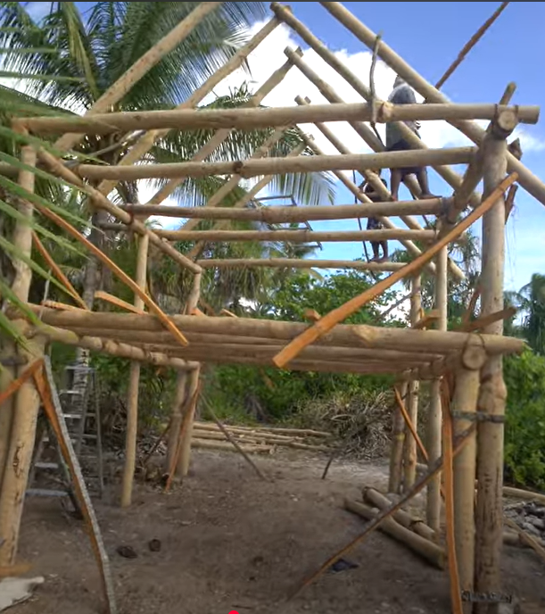
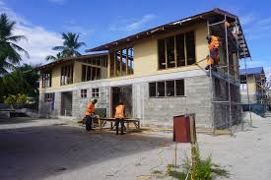

Slide 14
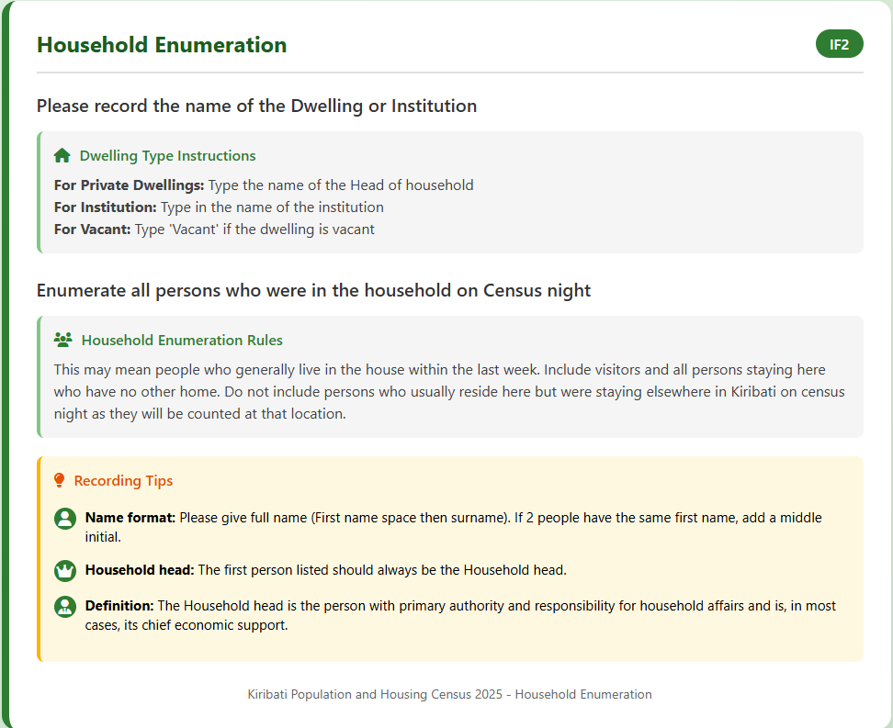
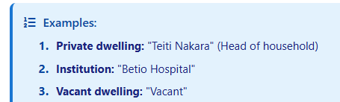
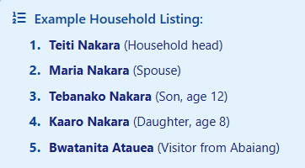

Slide 15
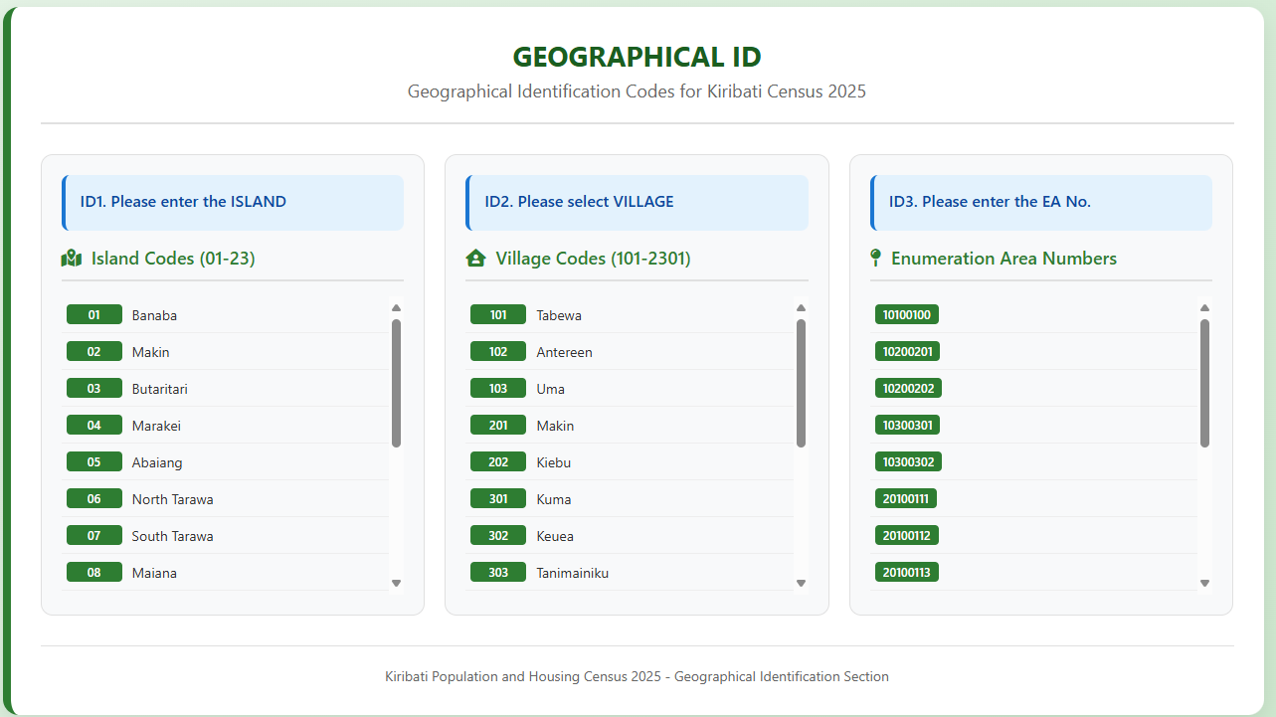

Slide 16
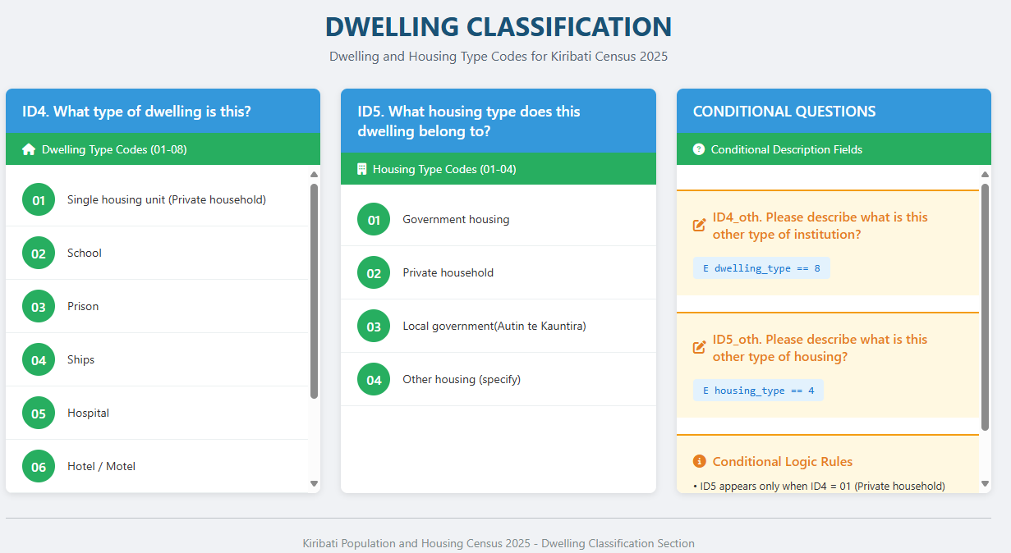

Slide 17
WHAT IS CENSUS NIGHT OR REFERENCE POINT?
Census Night refers to 7th November 2025 Midnight.
Whoever sleep in a particular household on the 7th of November night, should be included or counted at that particular household.
Its just like capturing the pictures of household members at that Midnight

Slide 18
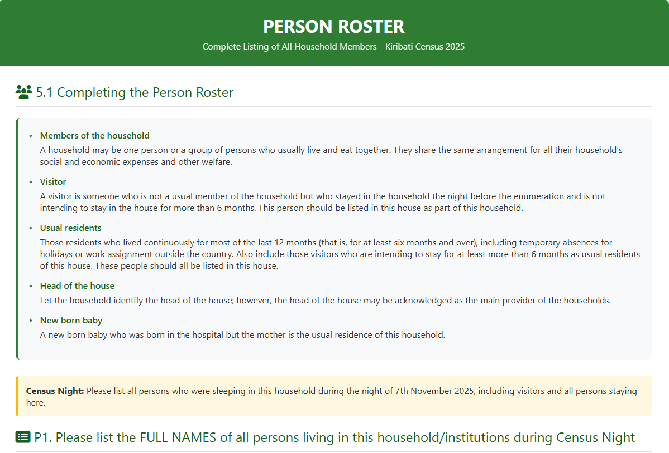

Slide 19
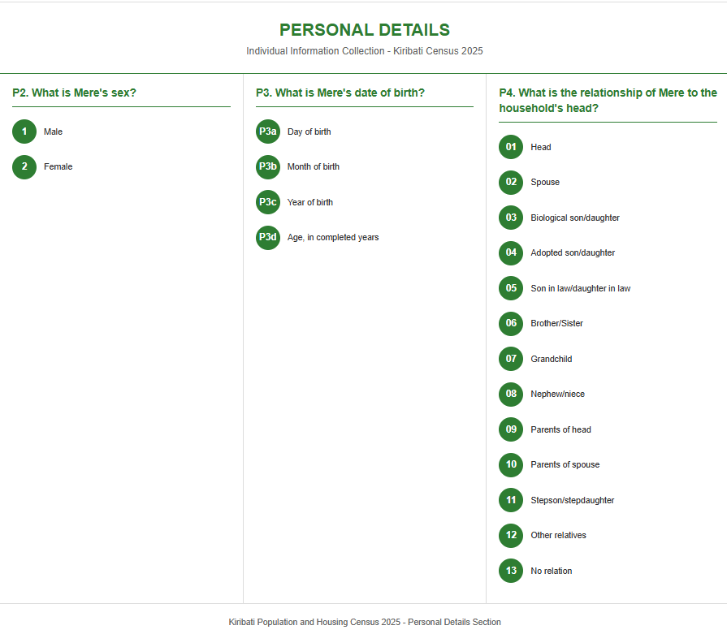

Slide 20
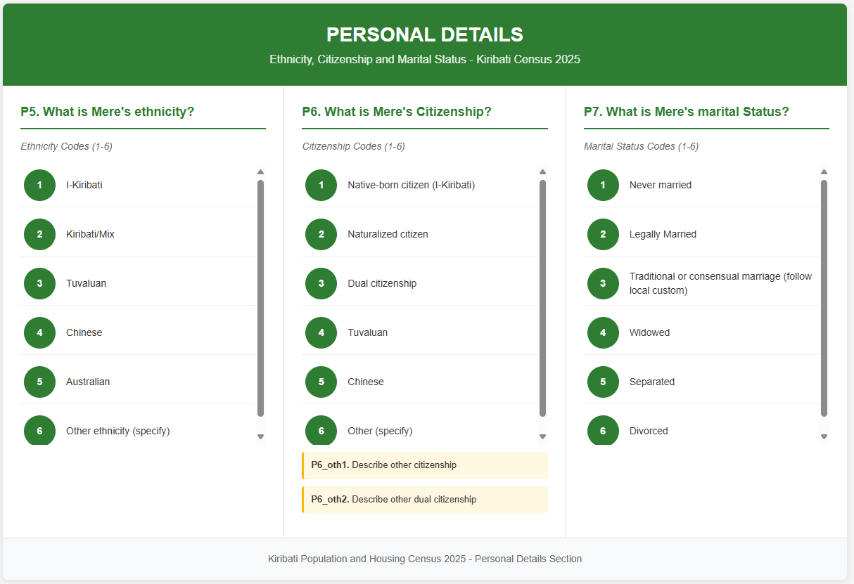

Slide 21
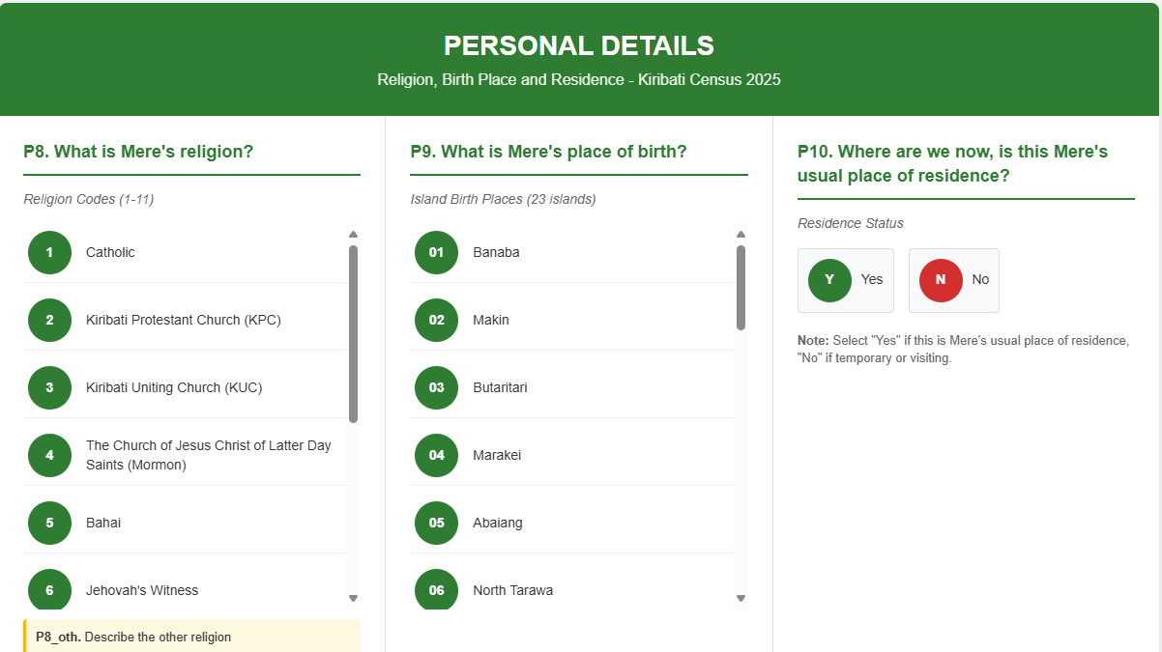

Slide 22
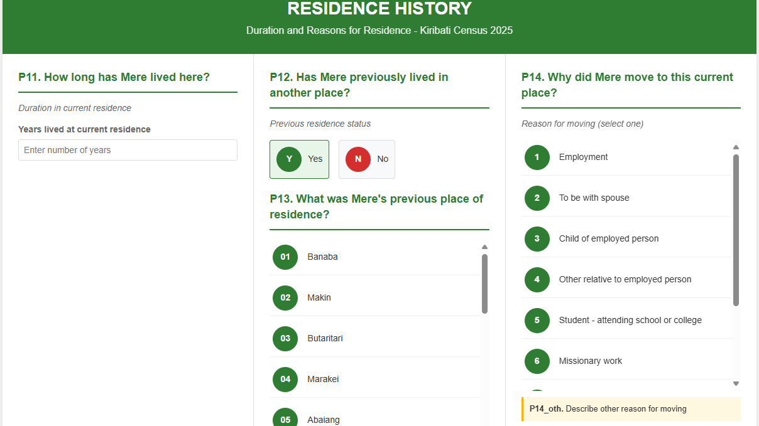

Slide 23
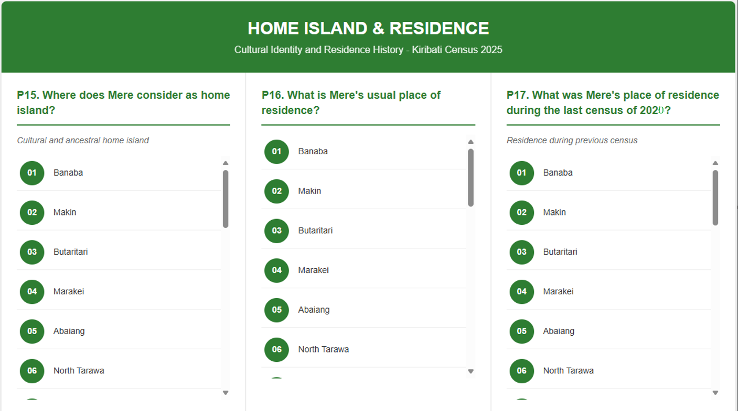

Slide 24
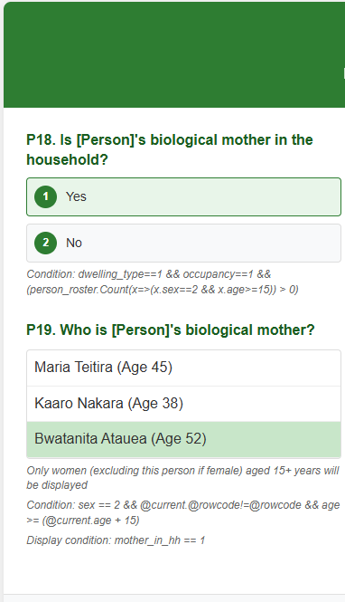
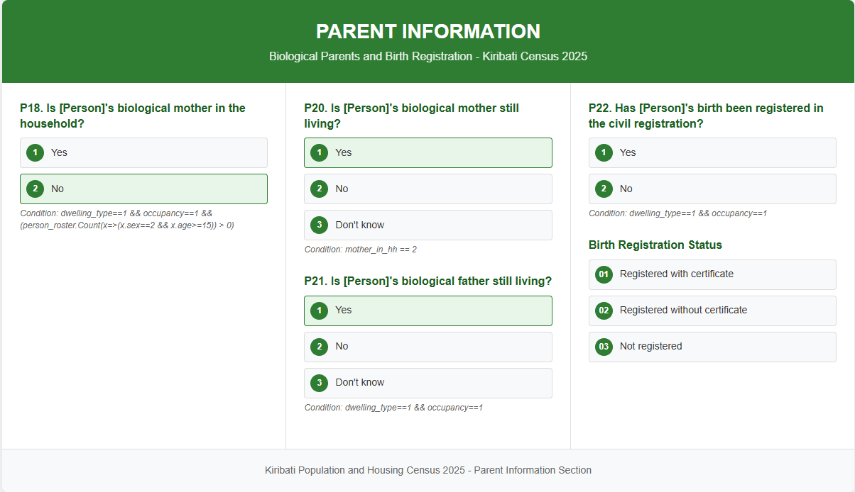

Slide 25
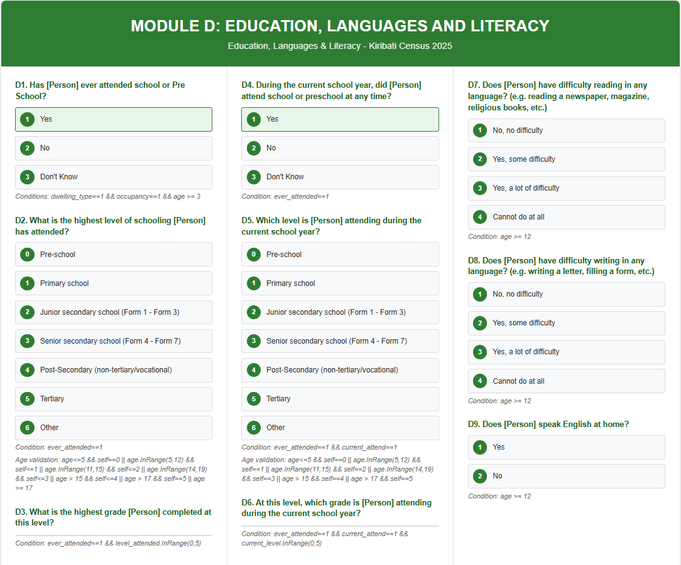

Slide 26
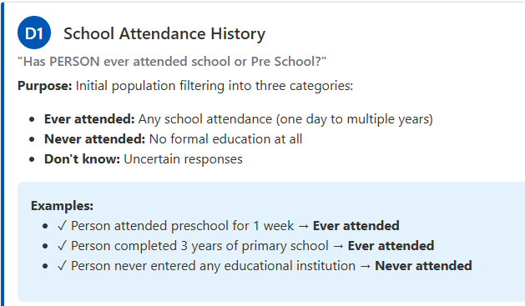
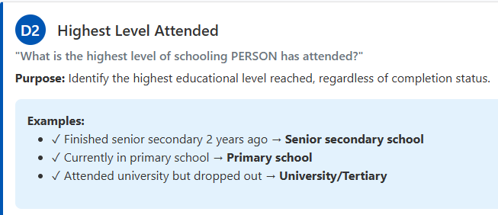
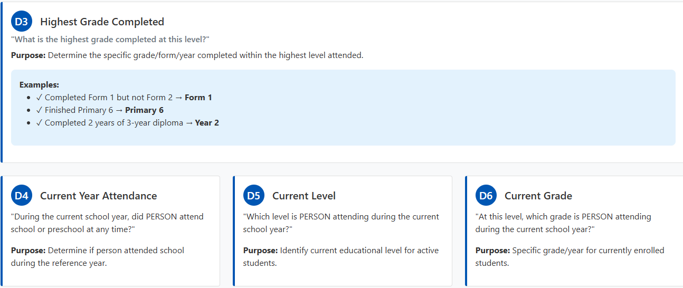

Slide 27
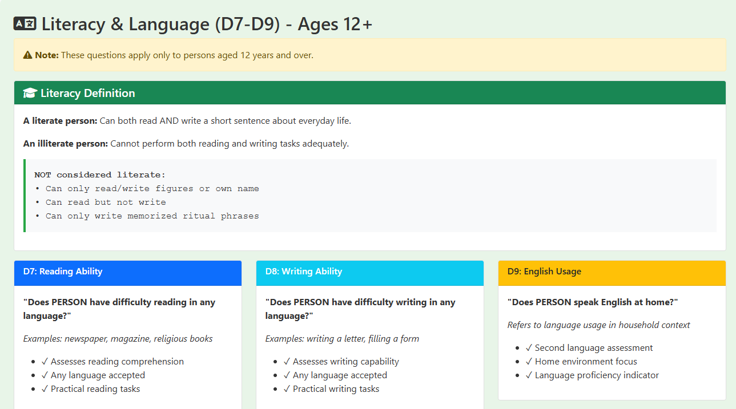

Slide 28
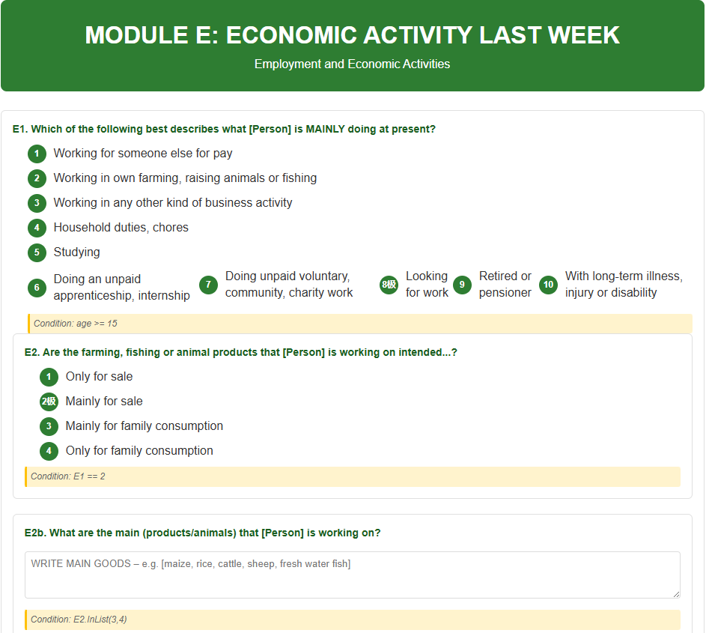

Slide 29
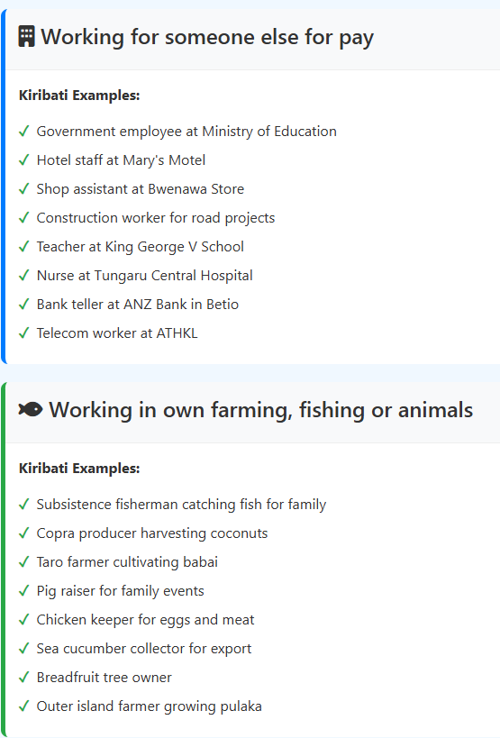
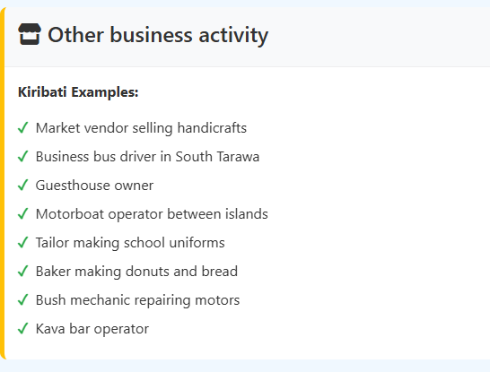

Slide 30
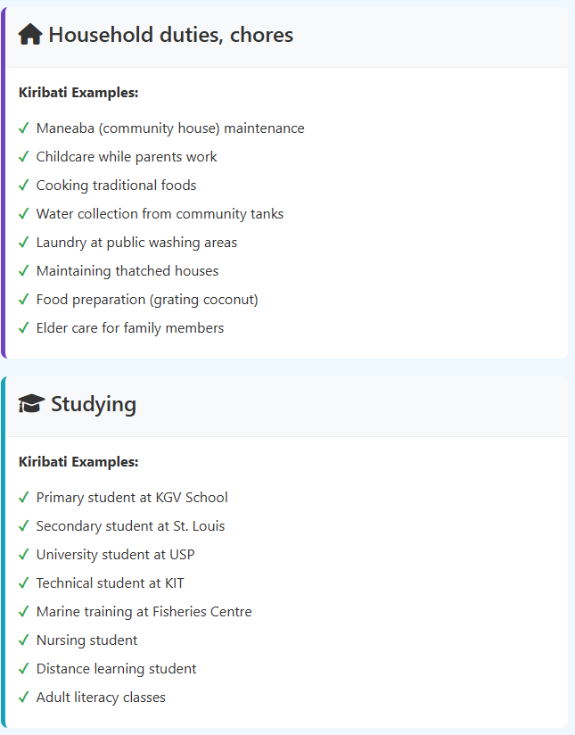
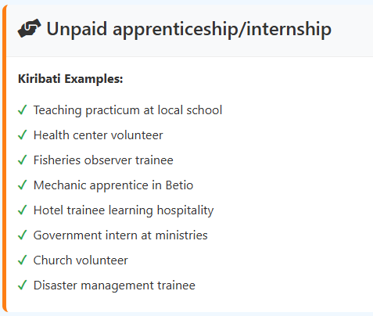
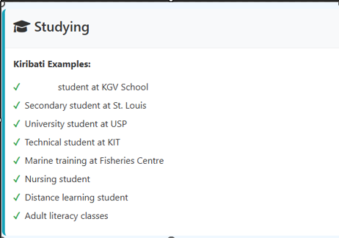

Slide 31
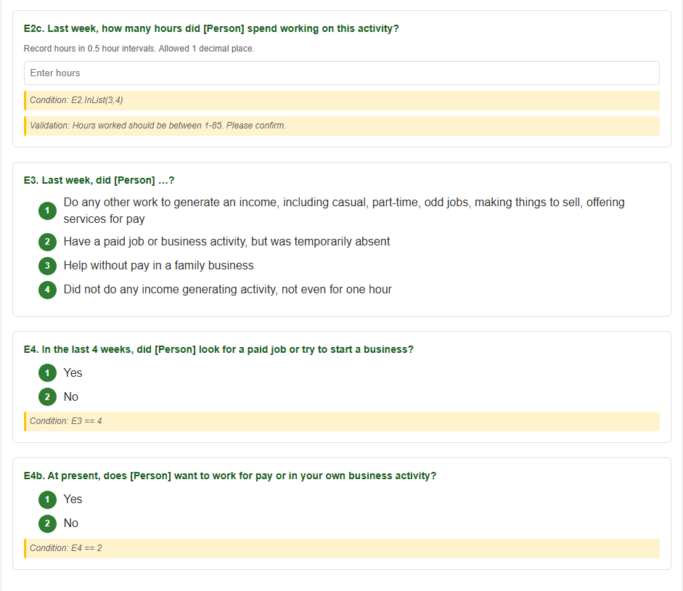

Slide 32
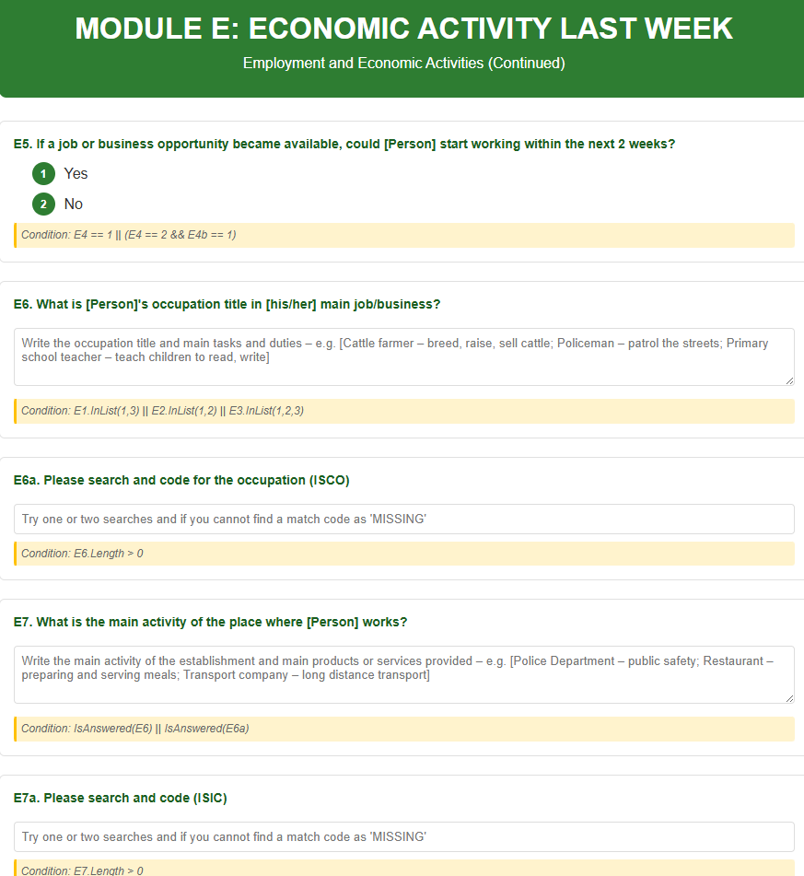

Slide 33
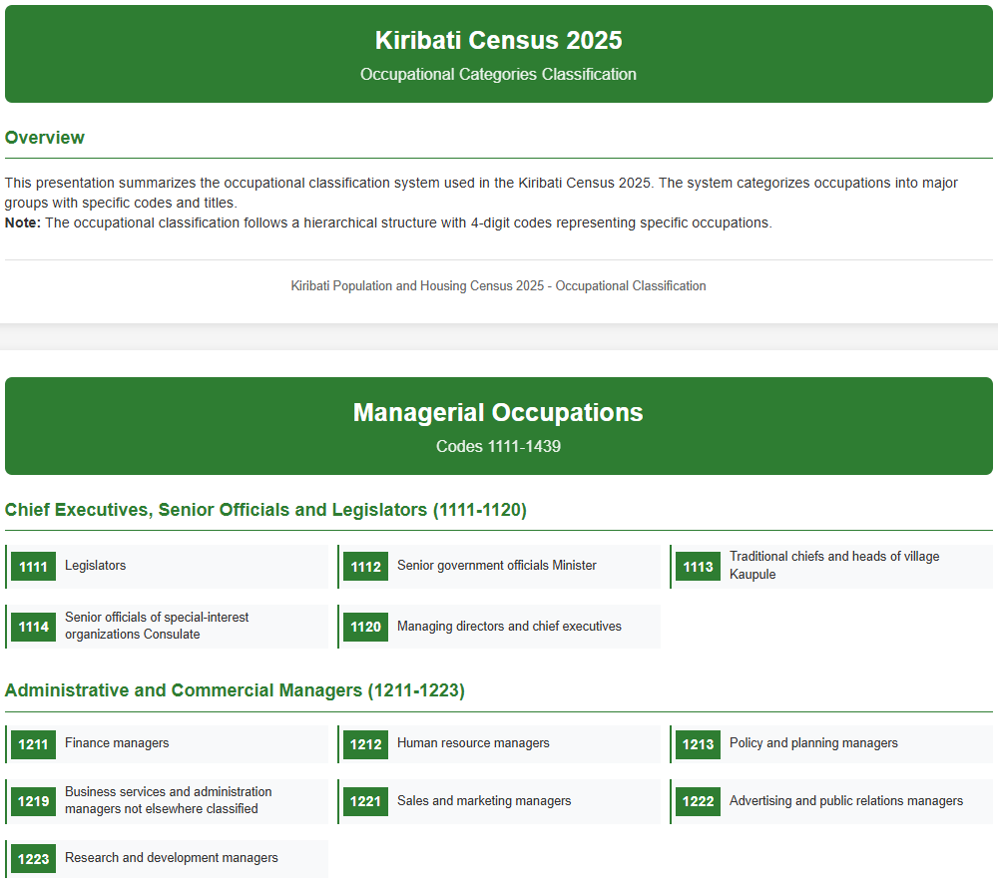

Slide 34
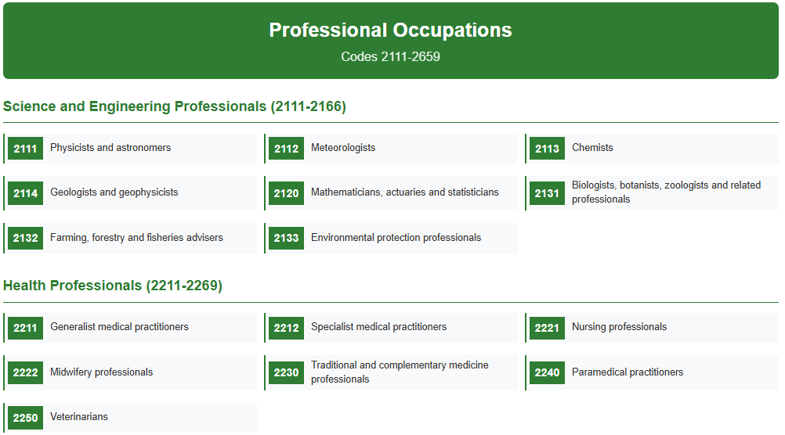

Slide 35
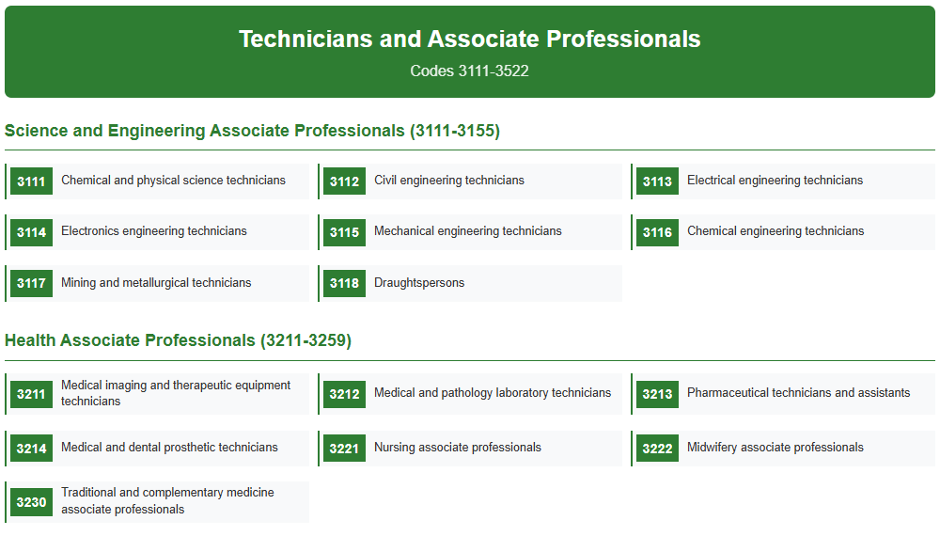

Slide 36
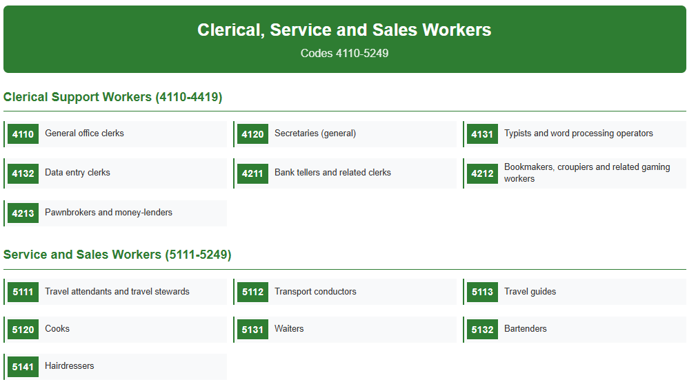

Slide 37


Slide 38
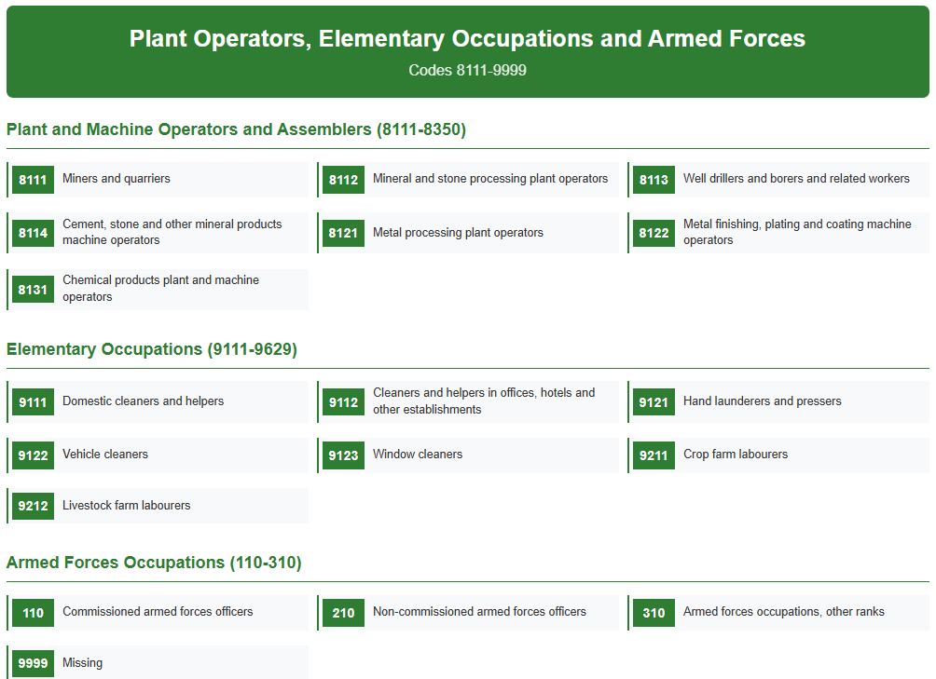

Slide 39
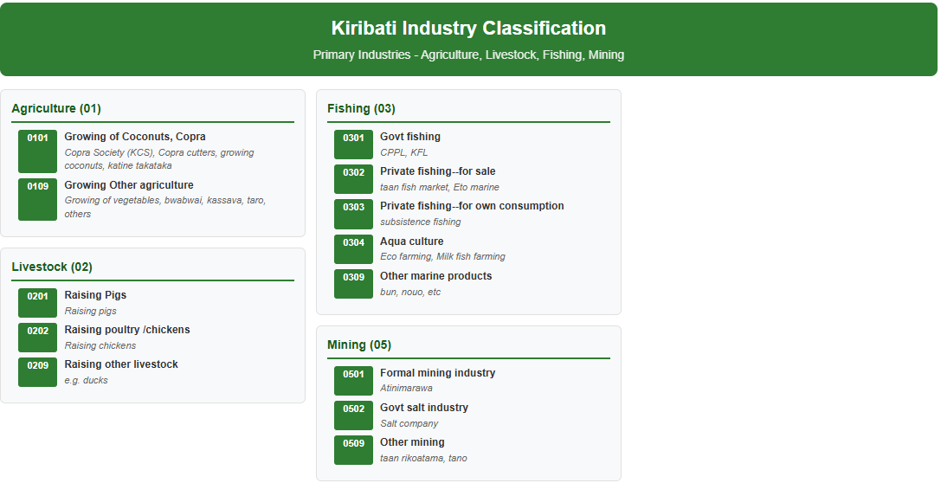

Slide 40
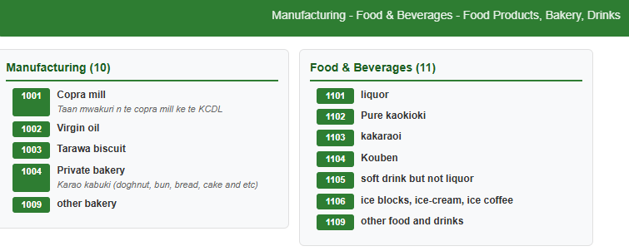
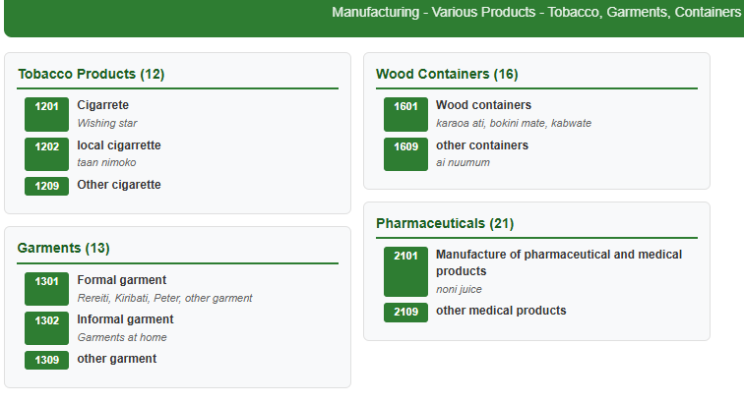
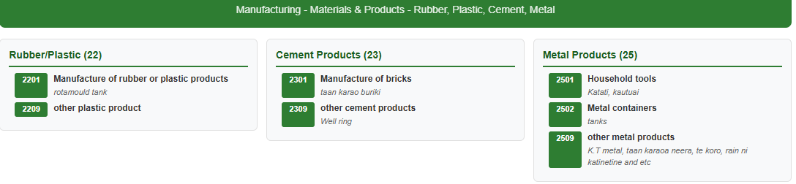

Slide 41
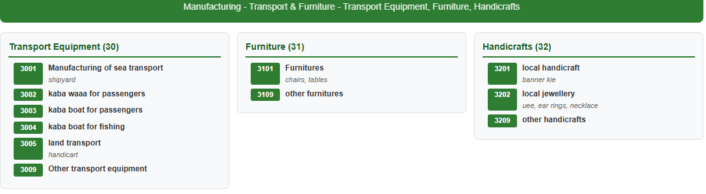
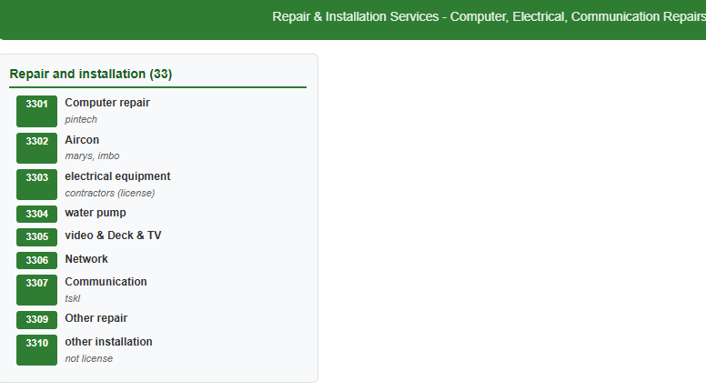
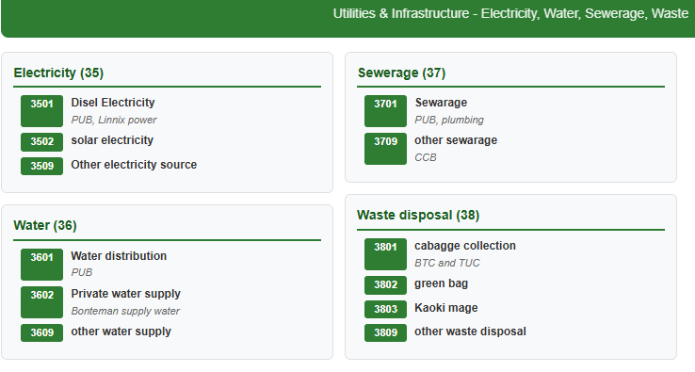

Slide 42
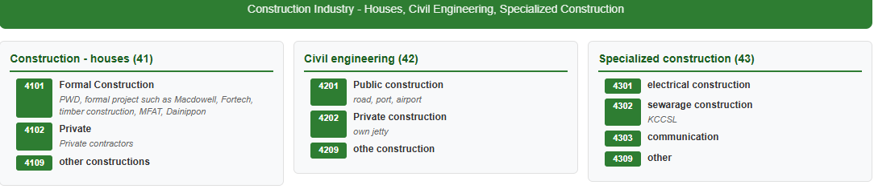
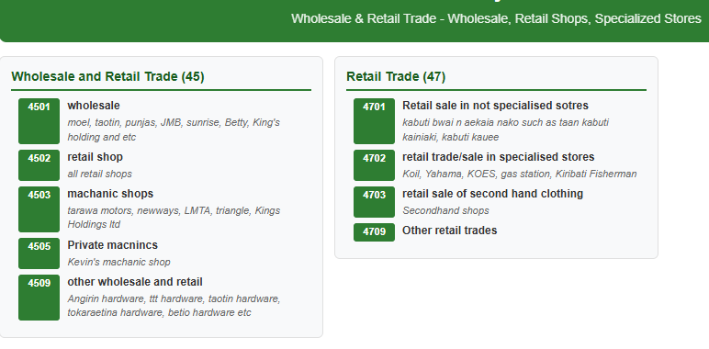


Slide 43




Slide 44



Slide 45



Slide 46



Slide 47




Slide 48




Slide 49



Slide 50



Slide 51



Slide 52


Slide 53


Slide 54


Slide 55


Slide 56



Slide 57



Slide 58



Slide 59


Slide 60


Slide 61


Slide 62



Slide 63



Slide 64




Slide 65


Slide 66




Slide 67


Slide 68





Aluminum
No wall
Wood
Traditional Material
Bricks cement

Slide 69



Slide 70







Slide 71






Slide 72




Slide 73







Slide 74




Slide 75


Slide 76


Slide 77


Slide 78


Slide 79


Slide 80


Slide 81


Slide 82


Slide 83


Slide 84


Slide 85


Slide 86




Slide 87




Slide 88



Slide 89
KAM RABWA

